Slide 1

ProtVista
Open-Source Protein Feature Visualisation with reusable Web Components
Aurélien Luciani
www.ebi.ac.uk
www.uniprot.org

Slide 2
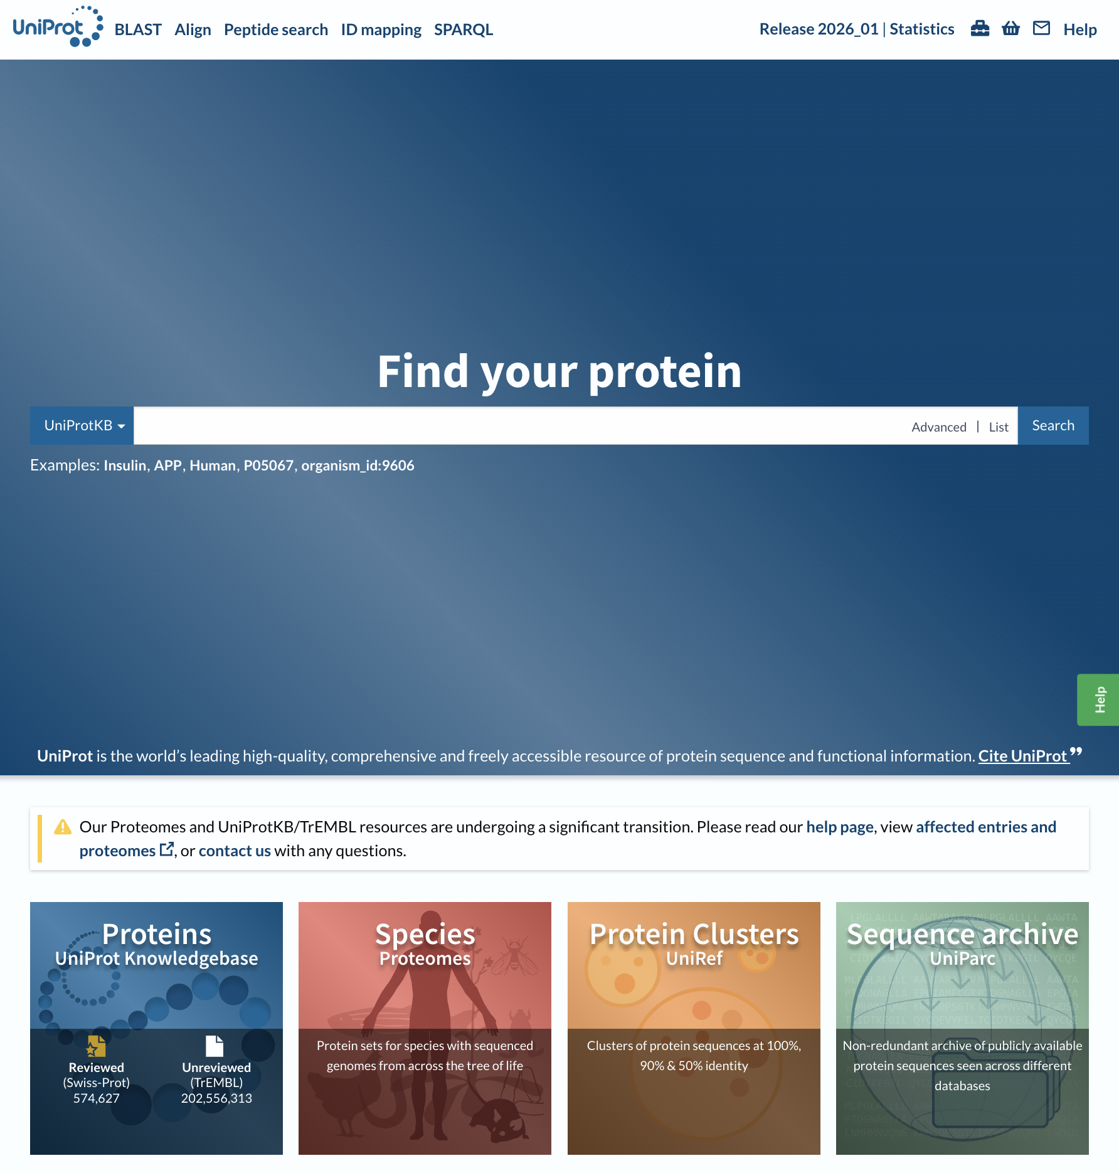



UniProt
A comprehensive, high-quality and publicly accessible resource of protein sequence and functional information
It includes, among other things:
Physiological protein function including subcellular location, pathways, reactions, interactions and involvement in disease
Sequence annotation of domains, PTMs, mutations, disease variants and much more
European Bioinformatics Institute (EMBL-EBI), Hinxton, Cambridge, UK
Protein Information Resource (PIR), Washington DC and Delaware, USA
SIB Swiss Institute of Bioinformatics (SIB), Geneva, Switzerland

Slide 3
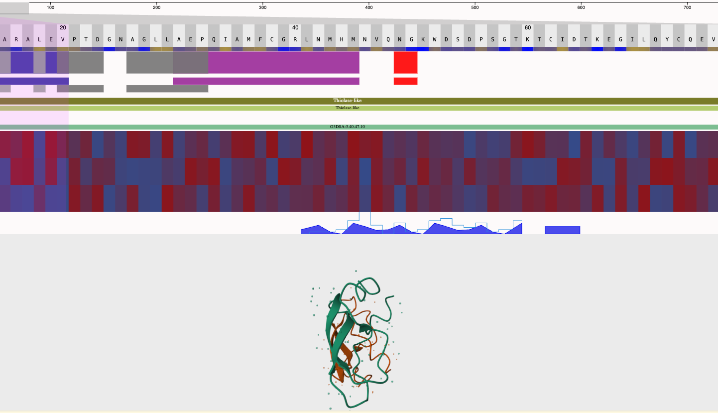


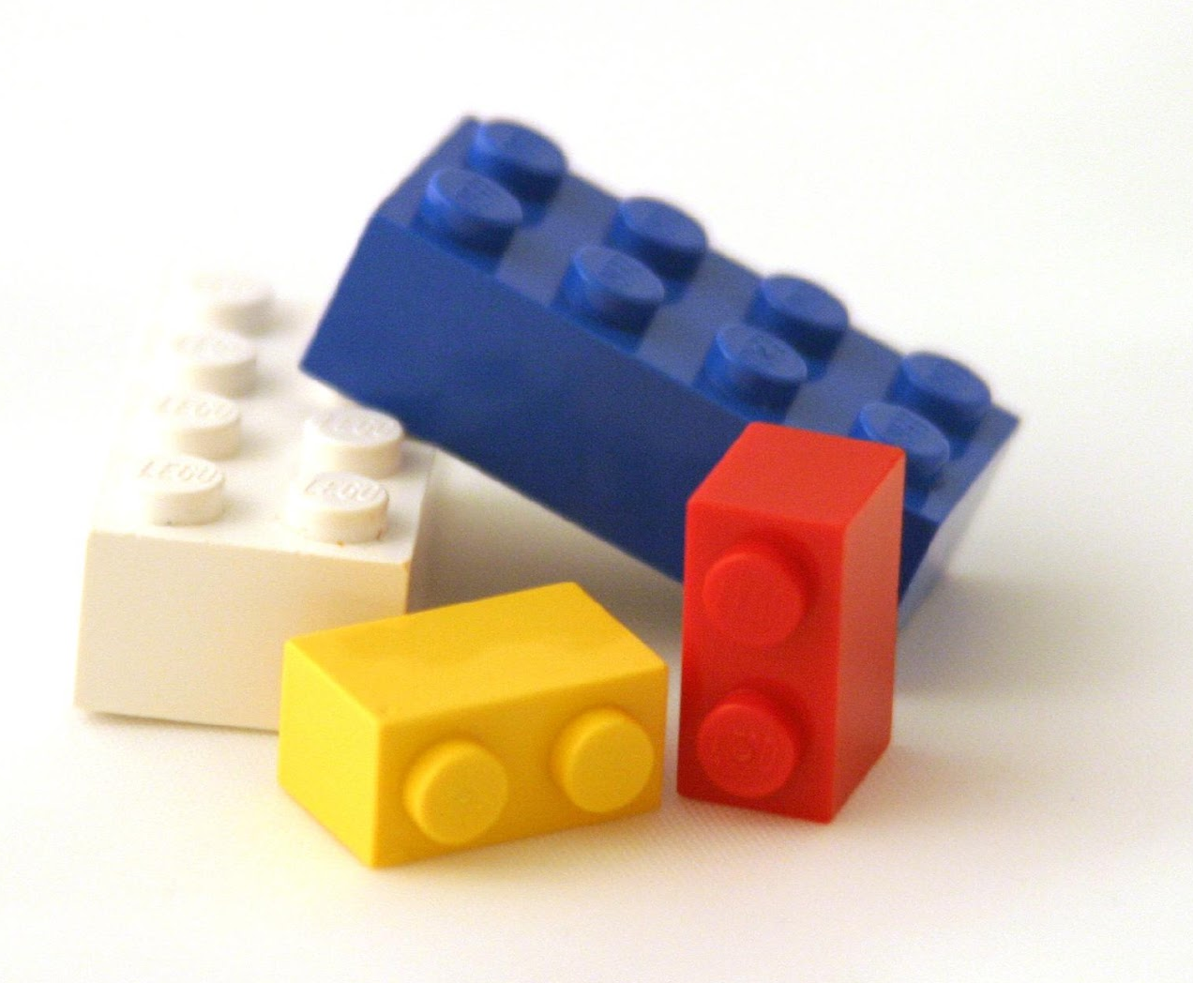
Nightingale
An open-source visualization library of standard web components
Designed for representing
protein-related data
Composable architecture facilitates vertical stacking of tracks, aiding visual comparison across datasets
Interoperable with other standard components, regardless of the underlying framework
Compatible with any component following the Nightingale APIs

Slide 4




Building using the standards: Web Components
Combination of standard APIs: Custom elements + Shadow DOM + HTML templates
Not dependent on any framework
Limited library dependencies
Set of components, as independent packages under the @nightingale-elements scope on NPM
…
React
and related
Angular
Vue.js
Vanilla JS

Slide 5
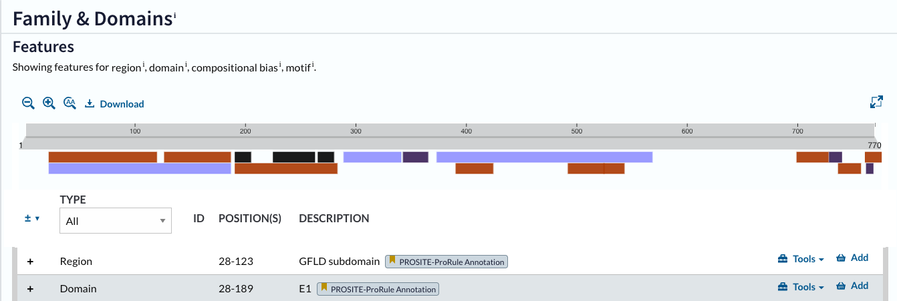
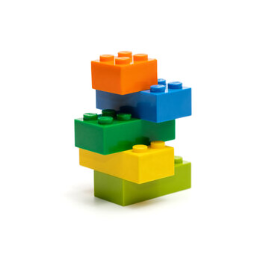
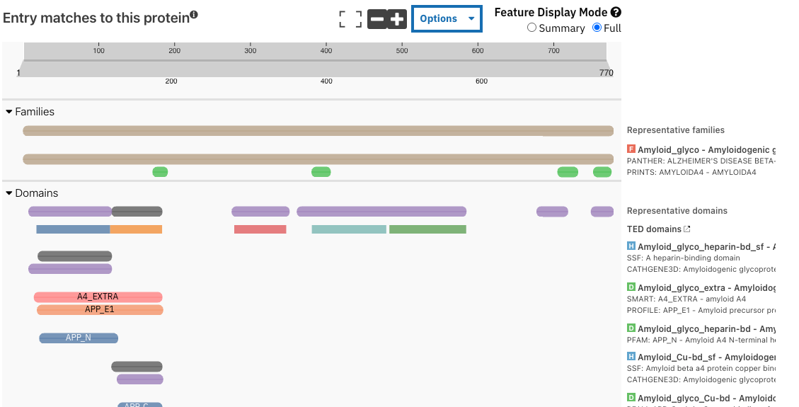
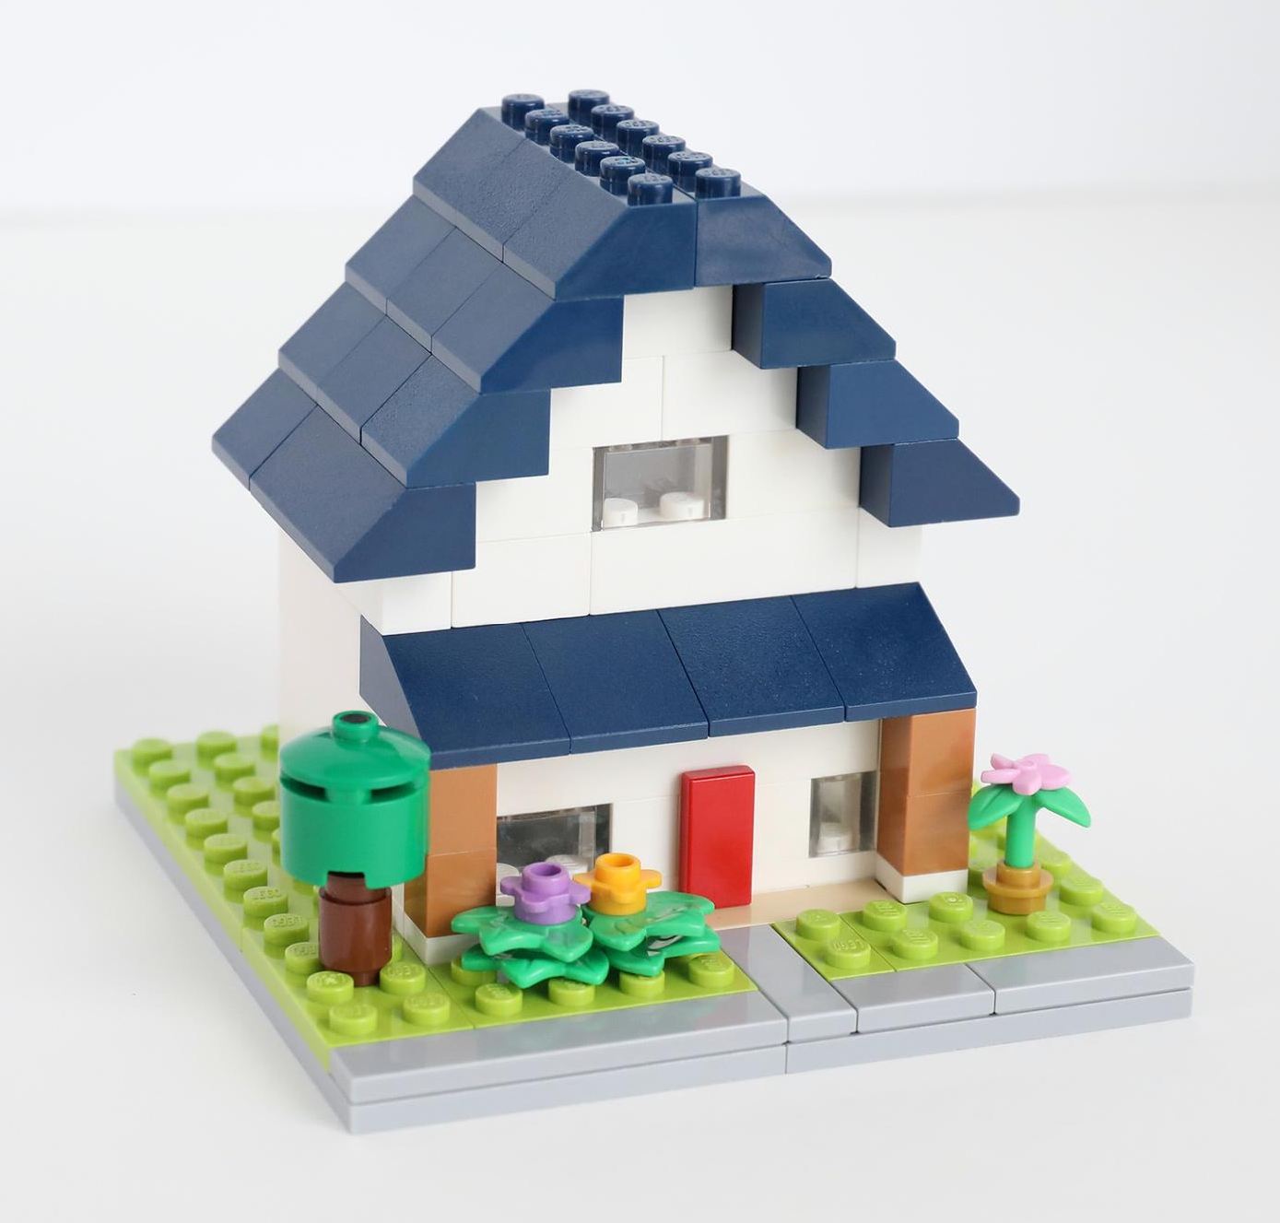
Same blocks, different results
Visualization showing family and domains in UniProt’s entry page of P05067 using minimal number of tracks as needed
InterPro’s protein viewer using Nightingale components for P05067
PDBe is an other user of Nightingale components

Slide 6
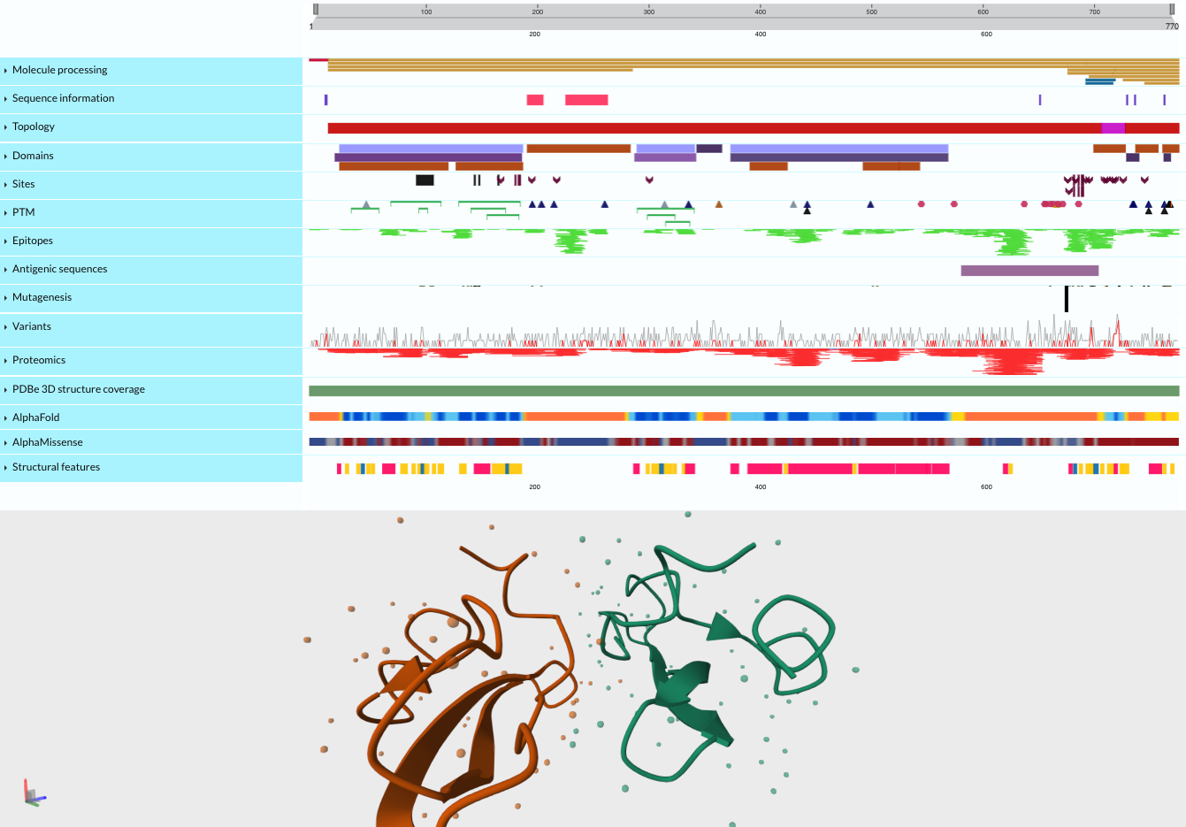
UniProt’s ProtVista visualization
Turnkey combination of tracks
Chooses and aligns various tracks to best fit our needs
Uses different components of Nightingale
Uses UniProt’s data source
Customizes tooltips as needed
Is itself a Web Component
Human Amyloid-beta precursor protein in UniProt’s ProtVista visualization
Image source: Adobe stock

Slide 7

The viewer is composed of tracks – the fundamental building blocks.
Human Amyloid-beta precursor protein in UniProt’s ProtVista visualization

Slide 8
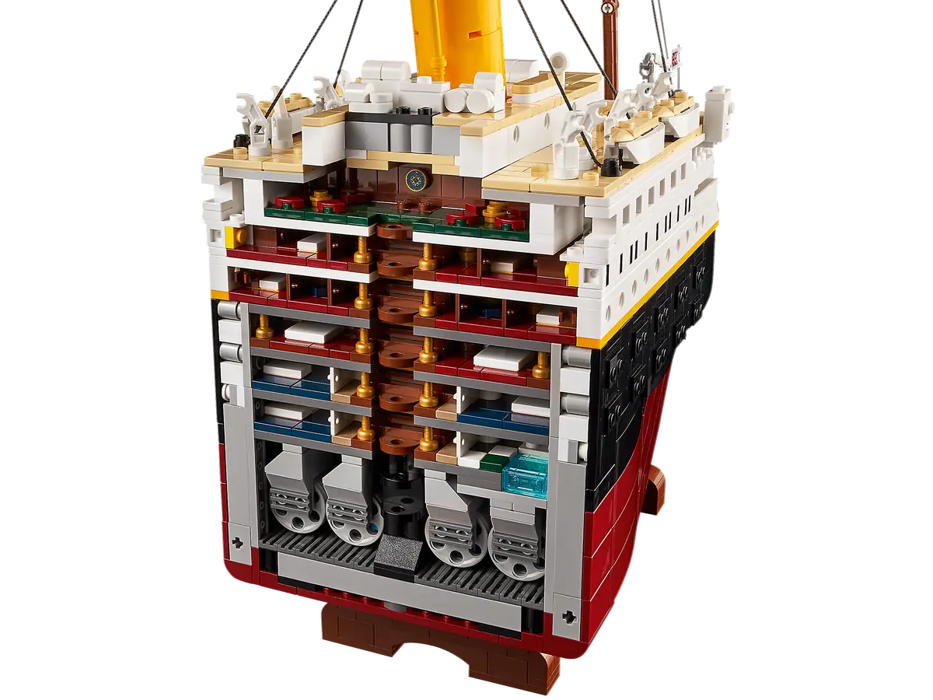
The viewer is composed of tracks – the fundamental building blocks.
Each track can be used individually or combined as shown here
Human Amyloid-beta precursor protein in UniProt’s ProtVista visualization

Slide 9
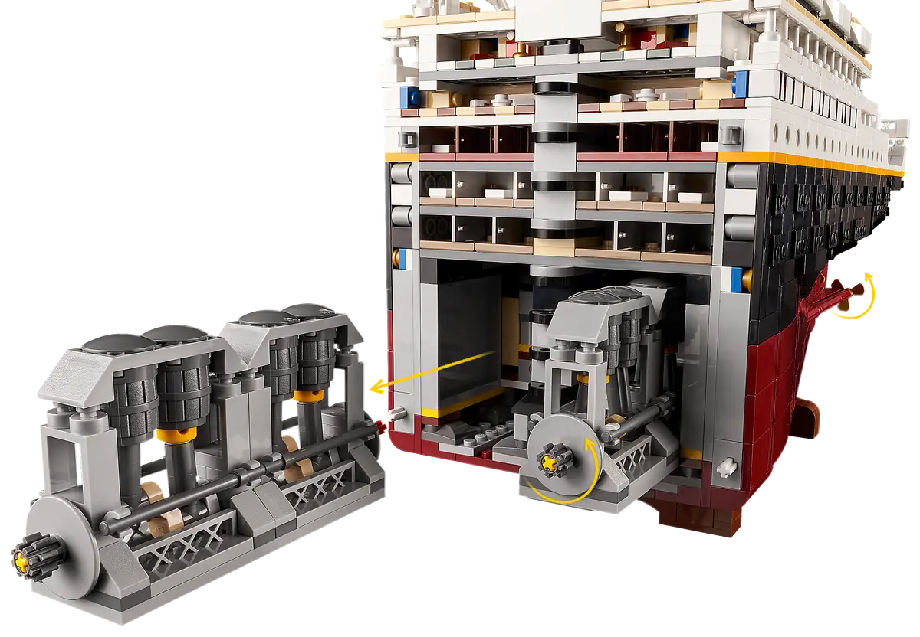
The viewer is composed of tracks – the fundamental building blocks.
Each track can be used individually or combined as shown here
ProtVista fetches all the data and each track is responsible for representing its own data.
Human Amyloid-beta precursor protein in UniProt’s ProtVista visualization

Slide 10
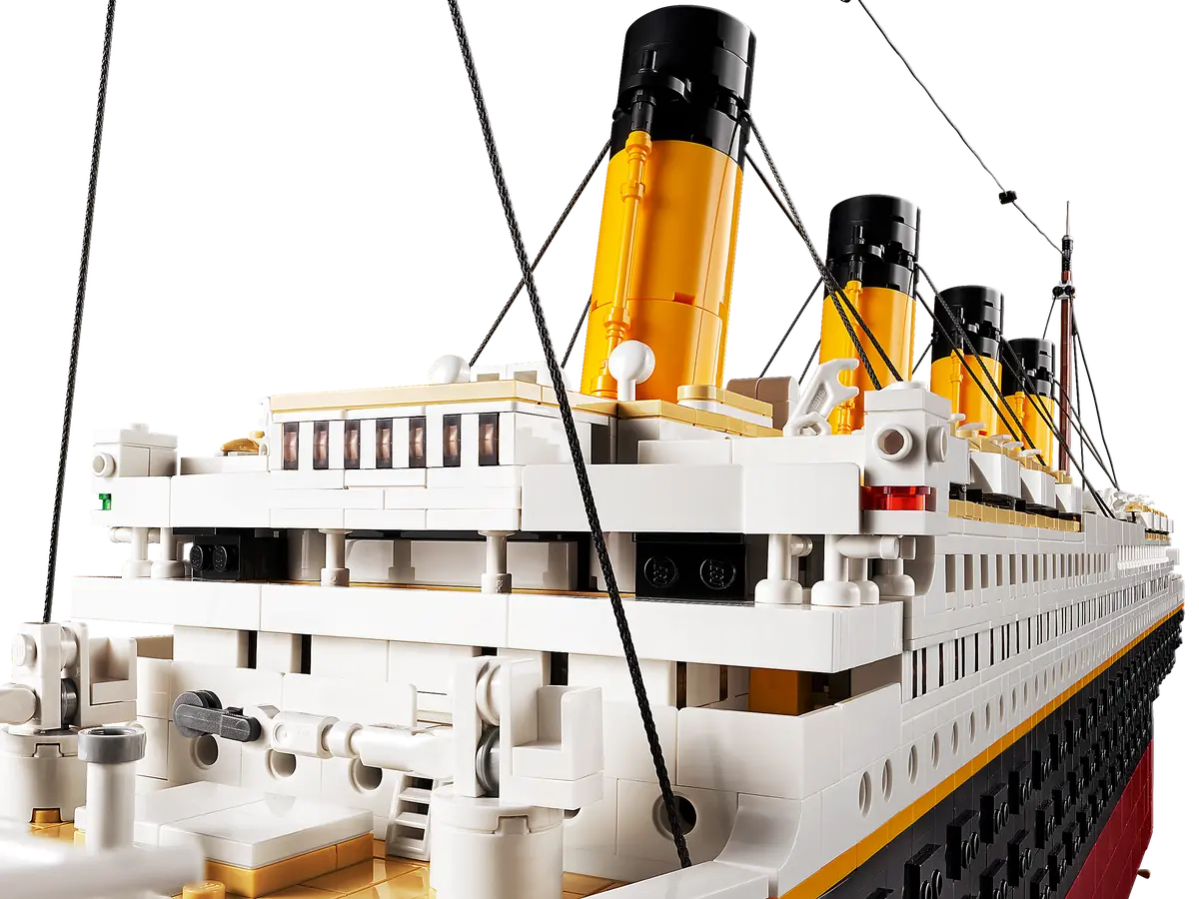
The viewer is composed of tracks – the fundamental building blocks.
Each track can be used individually or combined as shown here
ProtVista fetches all the data and each track is responsible for representing its own data.
The structure viewer is also treated as a track that render data in 3D context
Human Amyloid-beta precursor protein in UniProt’s ProtVista visualization

Slide 11
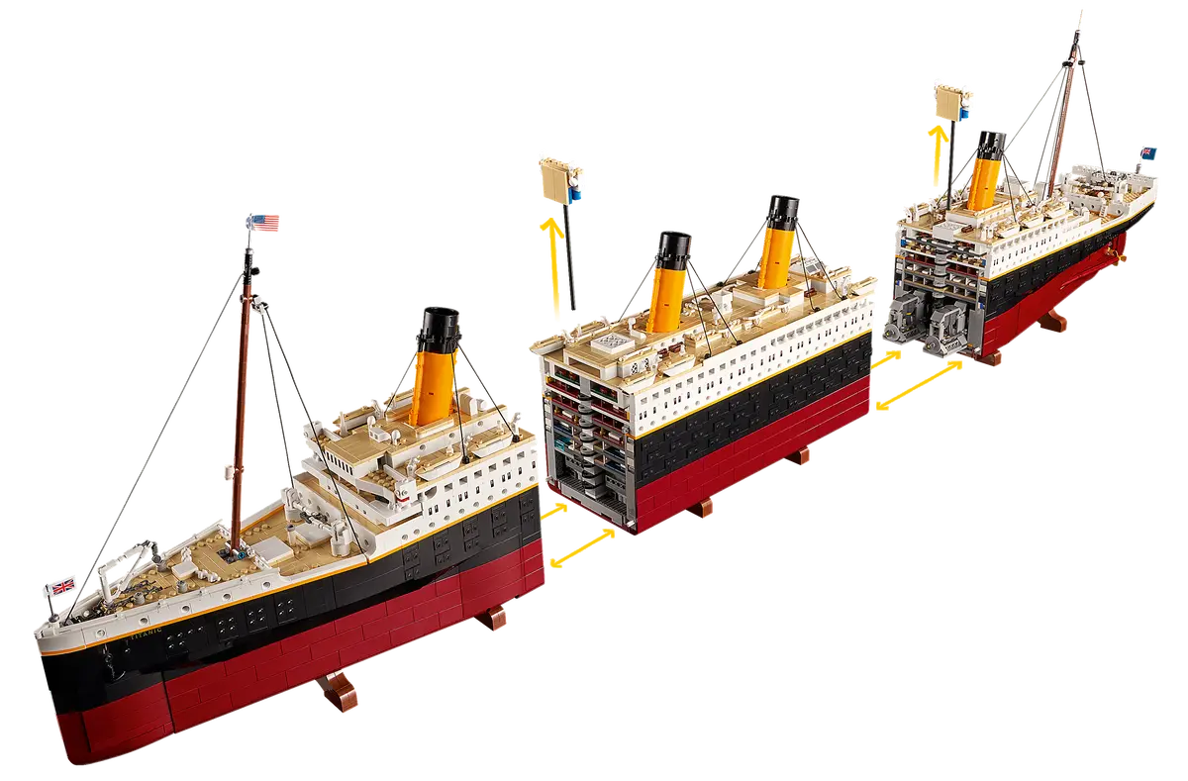
Architecture
The manager serves as a container for all the tracks, handling events from its descendants and ensuring synchronized behavior across tracks.
Manager
Sequence track
PTM track
Variant track
Sequence data
PTM data
Variants data
Image source: lego.com

Slide 12
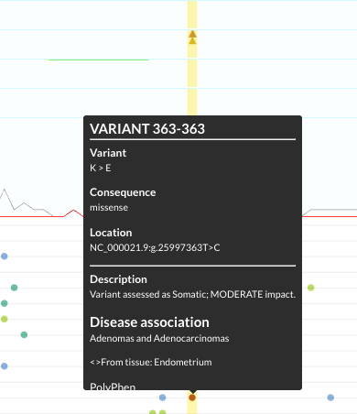
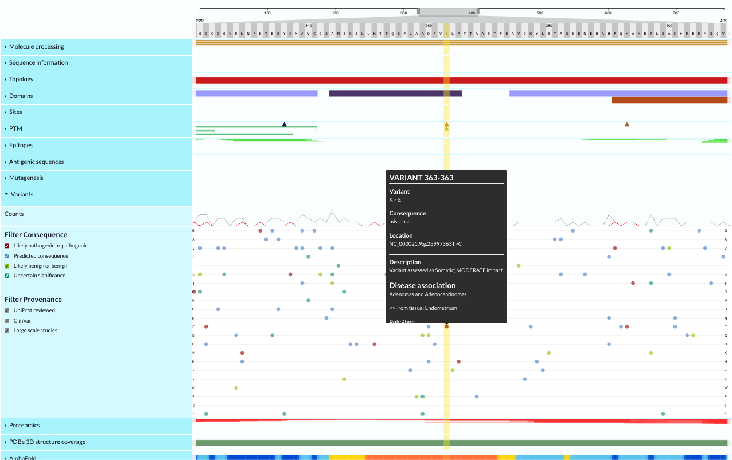
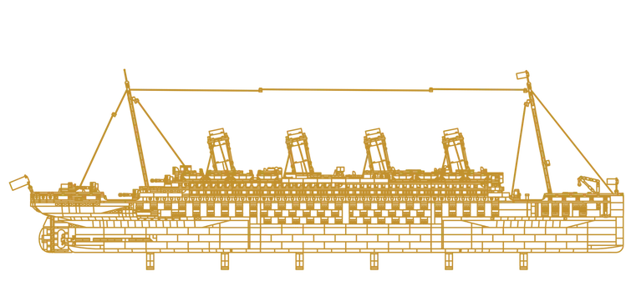
User clicks on a variant in the Variant track
Track emits a ‘highlight’ event with the selected coordinates
The manager detects the event
The manager sets the value to all the other tracks’ highlight attribute
Image source: lego.com

Slide 13
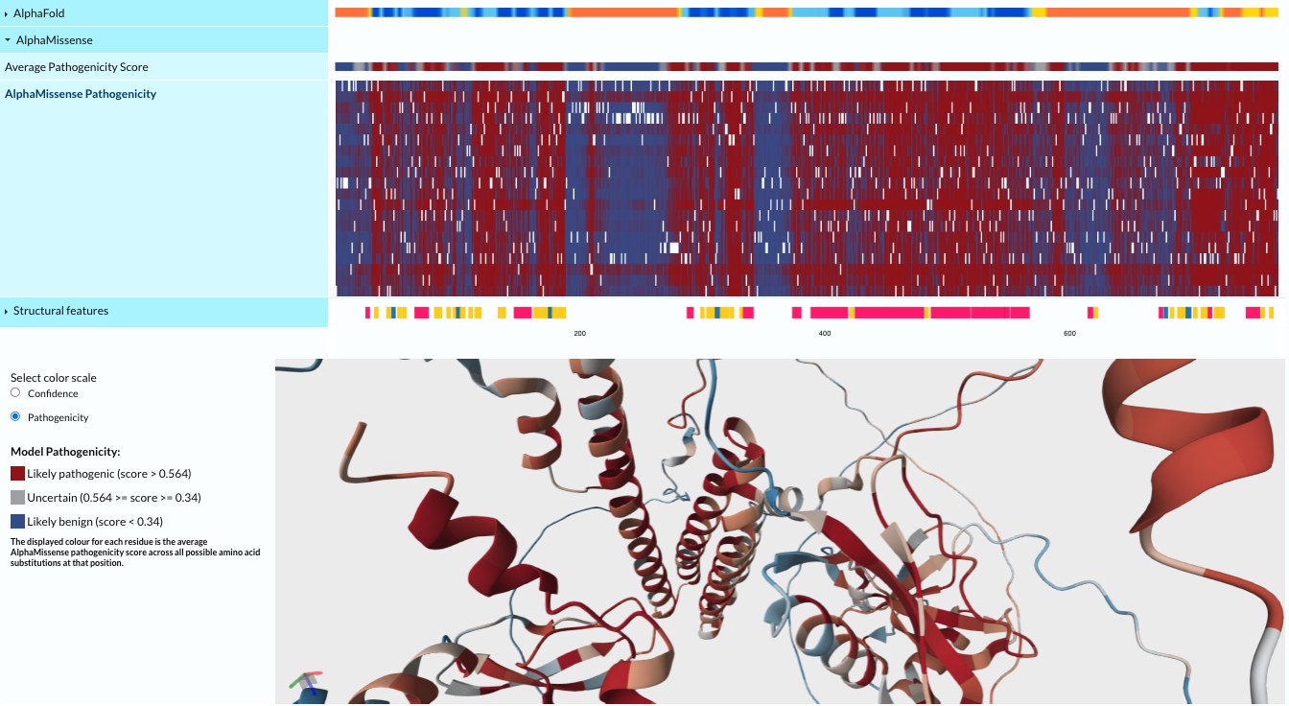
Under the hood
Lit - for building reusable Web Components
D3.js - for data-driven rendering via SVG and Canvas
HTML5 Canvas – leveraged for high performance rendering in heavily used tracks
SVG overlay – enables interactivity on top of Canvas for minimal performance impact
Rendered using Canvas
Pixels drawn directly onto the screen
Doesn’t retain all the elements in the DOM like SVG
Reduces memory overhead

Slide 14
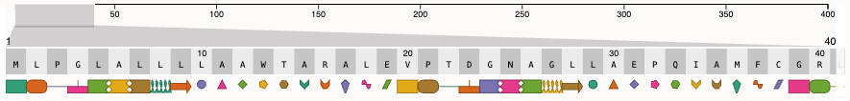
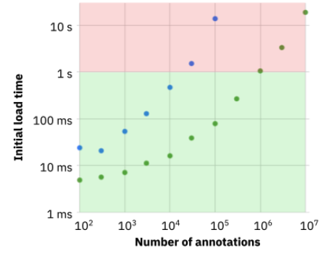
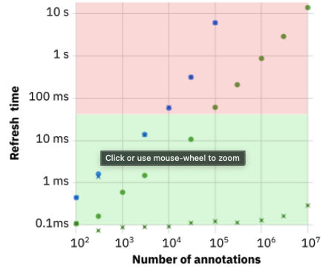
Performance optimization
Performance comparison between SVG and Canvas when visualizing the same dataset
SVG
x
SVG when zoomed on 100 residues
Canvas
x
Canvas when zoomed on 100 residues
Notes:
Initial Load: Canvas handles up to 1 million annotations in under 1 second, while SVG becomes significantly slower—up to 100x slower.
Interaction Time: During interaction, response time matters. Users expect updates in under 100 milliseconds. Canvas maintains this threshold for up to 100,000 annotations, especially when zoomed in to regions like 100 residues.
We’re still migrating more tracks to Canvas to improve responsiveness and performance.

Slide 15
Challenges and future
From no dependency, to minimum dependencies
  Avoiding footguns
  Embracing TypeScript
Package publication best practices
  Managing monorepos & bundles
Performance improvements
  Full transition to Canvas
  Explore WebGL
Improve developer and user experiences
Engaging a wider community

Slide 16




Funding
It is a collaboration with InterPro and PDBe and licensed under the MIT License.
UniProt is is funded by joint awards by the National Institute of Health (NIH) [U24HG007822]; European Molecular Biology Laboratory (EMBL) core funds; Wellcome Trust [221320/Z/20/Z]; the UK Biotechnology and Biological Science Research Council [BB/W017970/1] and the United States National Science Foundation (NSF) [DBI-2129634]
Further ProtVista development will be supported by the
Research Software Maintenance Fund, managed by the
Software Sustainability Institute and funded by
UKRI grant reference AH/Z000114/1

Slide 17

GitHub
Nightingale monorepo
https://github.com/ebi-webcomponents/nightingale
Nightingale Example pages
https://ebi-webcomponents.github.io/nightingale
ProtVista repo
https://github.com/ebi-webcomponents/protvista-uniprot
Any questions? 💬
Notes:
If you’d like to explore the components, here’s a link to our live demo.

